Slide 1
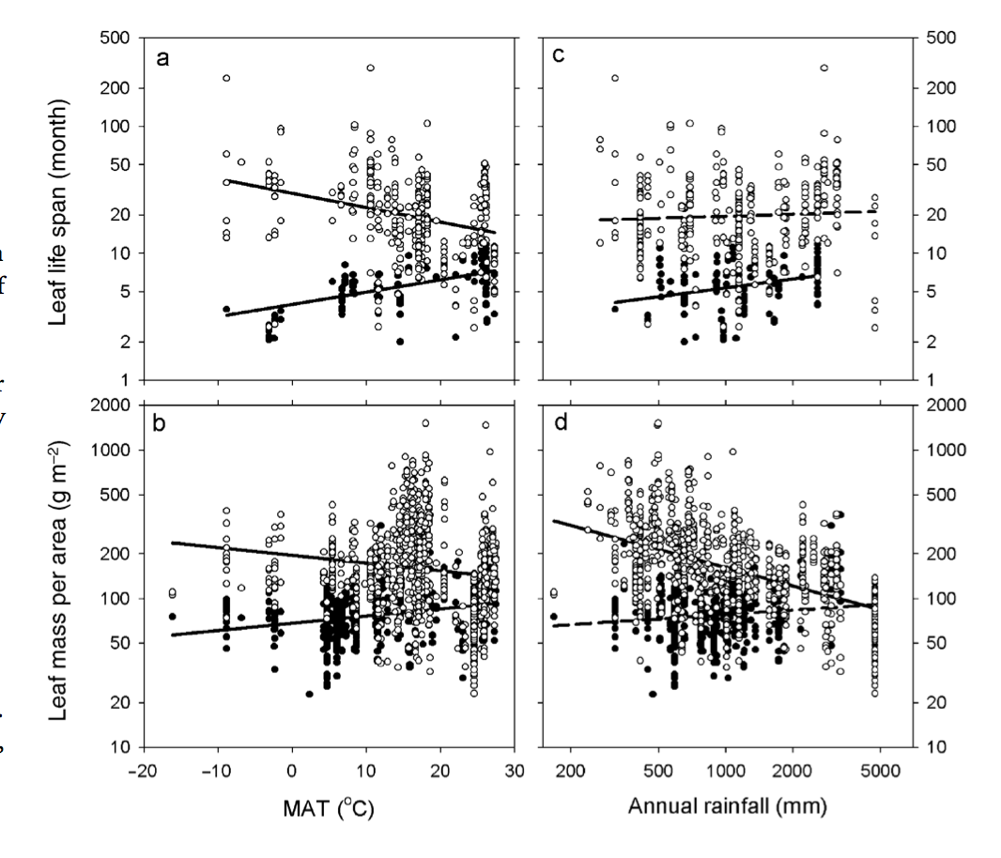
Wright et al. 2005 Glob. Ecol. Bioegeography

Slide 2
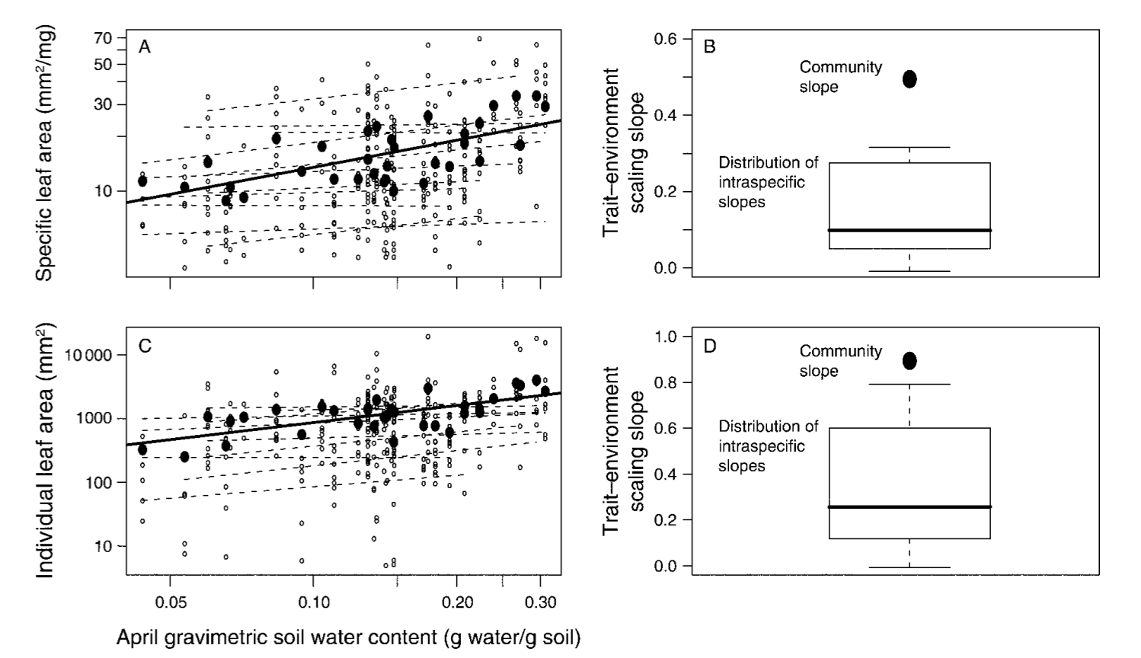
Cornwell and Ackerly 2009 Ecol. Monogr.

Slide 3
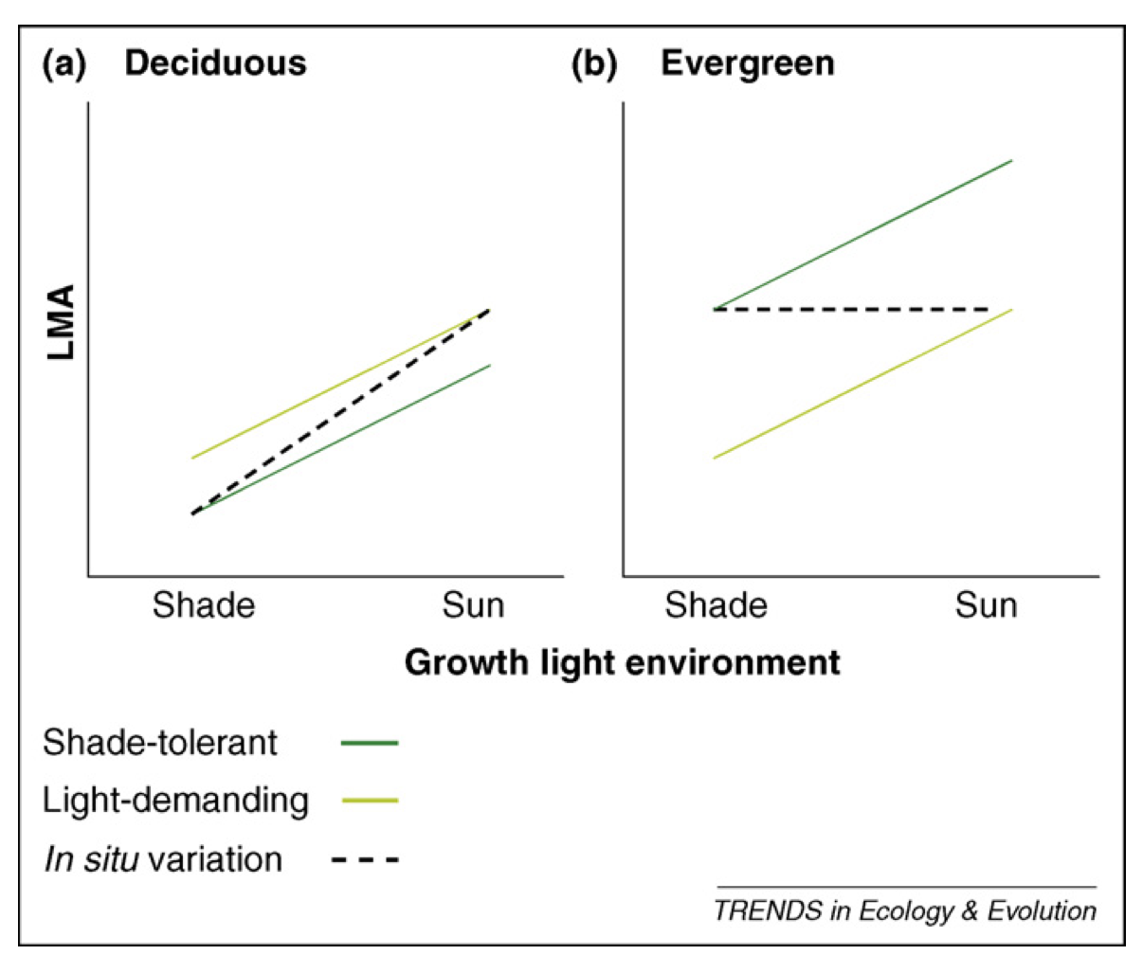
Lusk et al. 2008 TREE

Slide 4
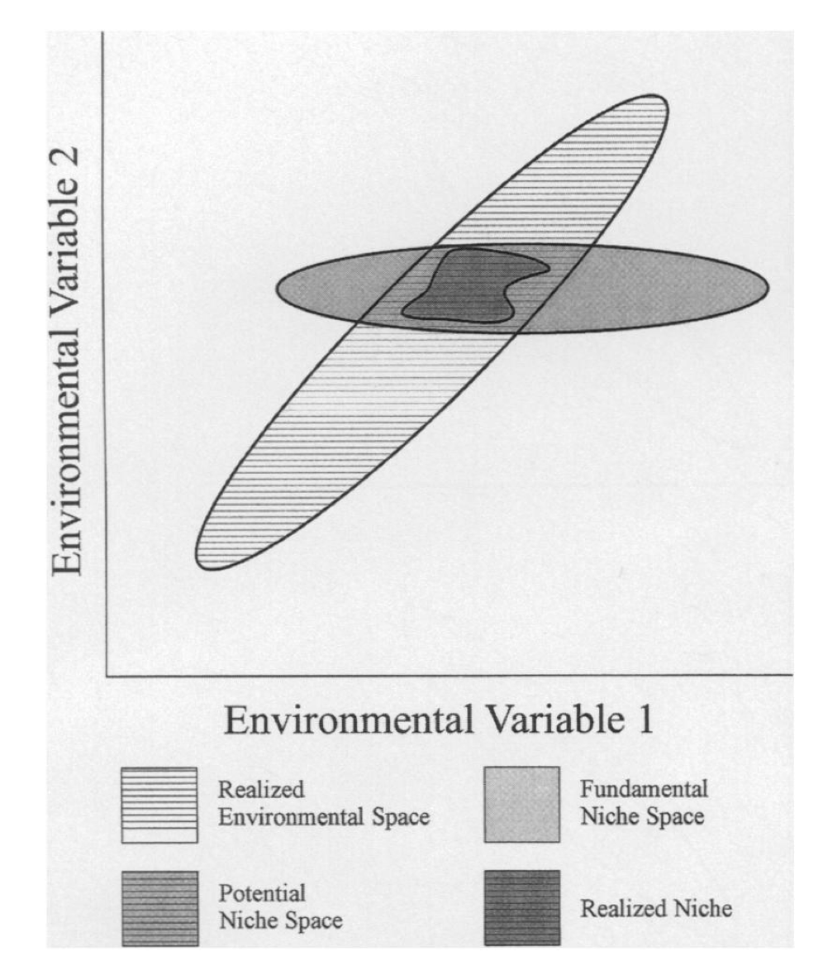
Jackson and Overpeck 2000 Paleobiology

Slide 5
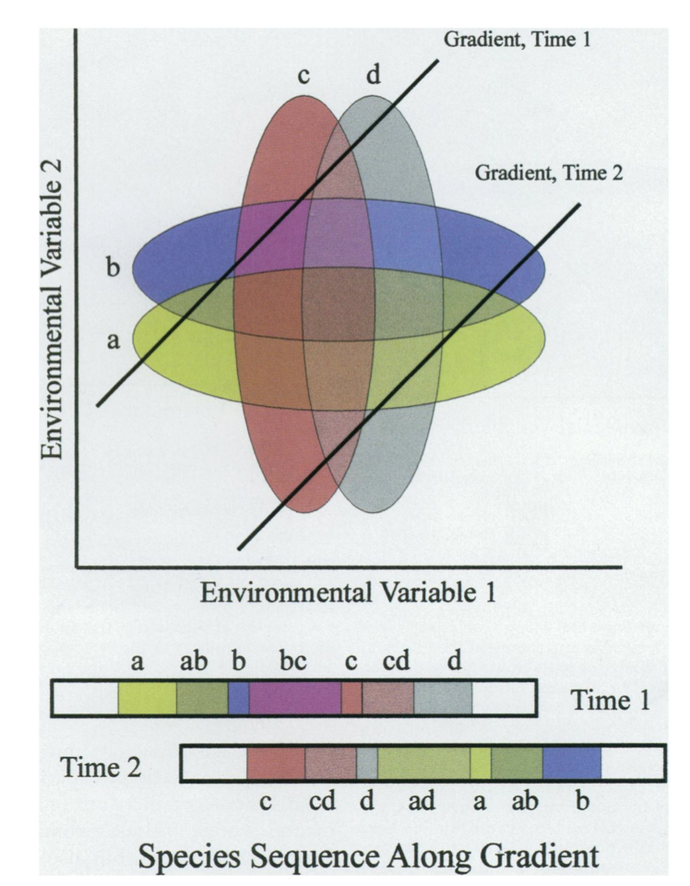
Jackson and Overpeck 2000 Paleobiology

Slide 6
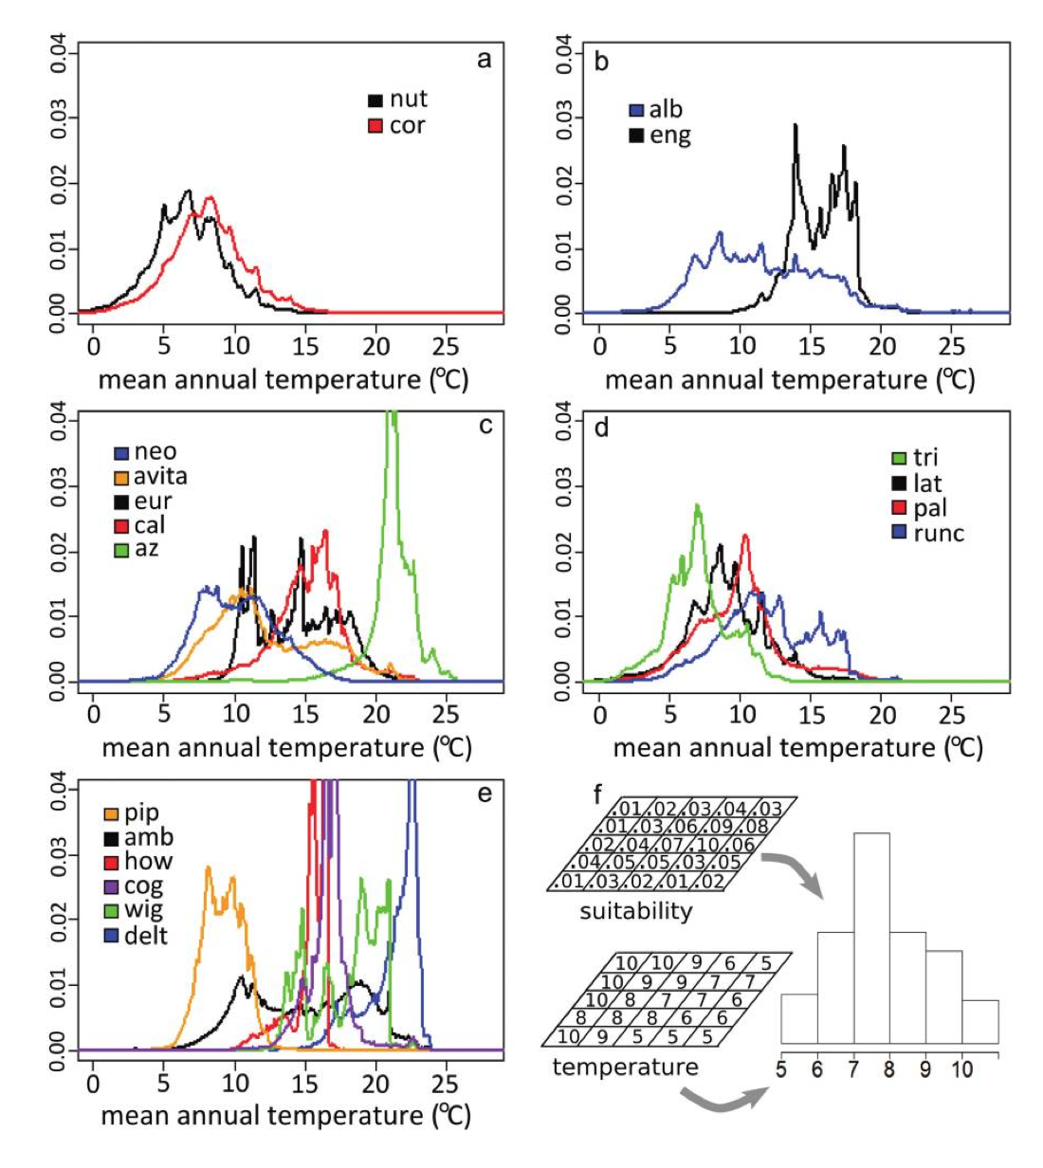
Evans et al. 2009 American Naturalist

Slide 7
